Slide 1

Project – Introduction to Part 1
Lecture ME 454
Modeling and Optimization of Energy Systems
Prof. F. Maréchal
Eduardo Pina,
Sai Ravi, Michele Poli
Fall 2025

Slide 2
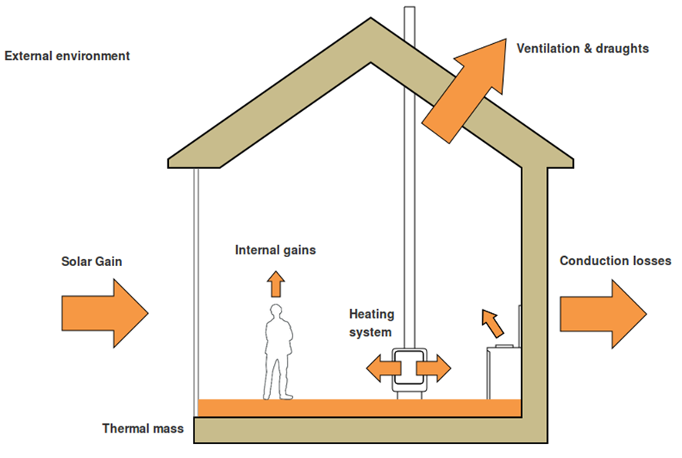
Hourly heating demand
Conduction & Ventilation
Internal gains
Solar gain

Slide 3
Outline Part 1
Identification of typical heat and electricity demand per building
Task 1: Estimation of internal heat gains
Task 2: Calculation of building envelope properties
Task 3: Calculation of the hourly demand
Task 4: Analysis on impact of renovation
Task 5: Clustering of typical days

Slide 4
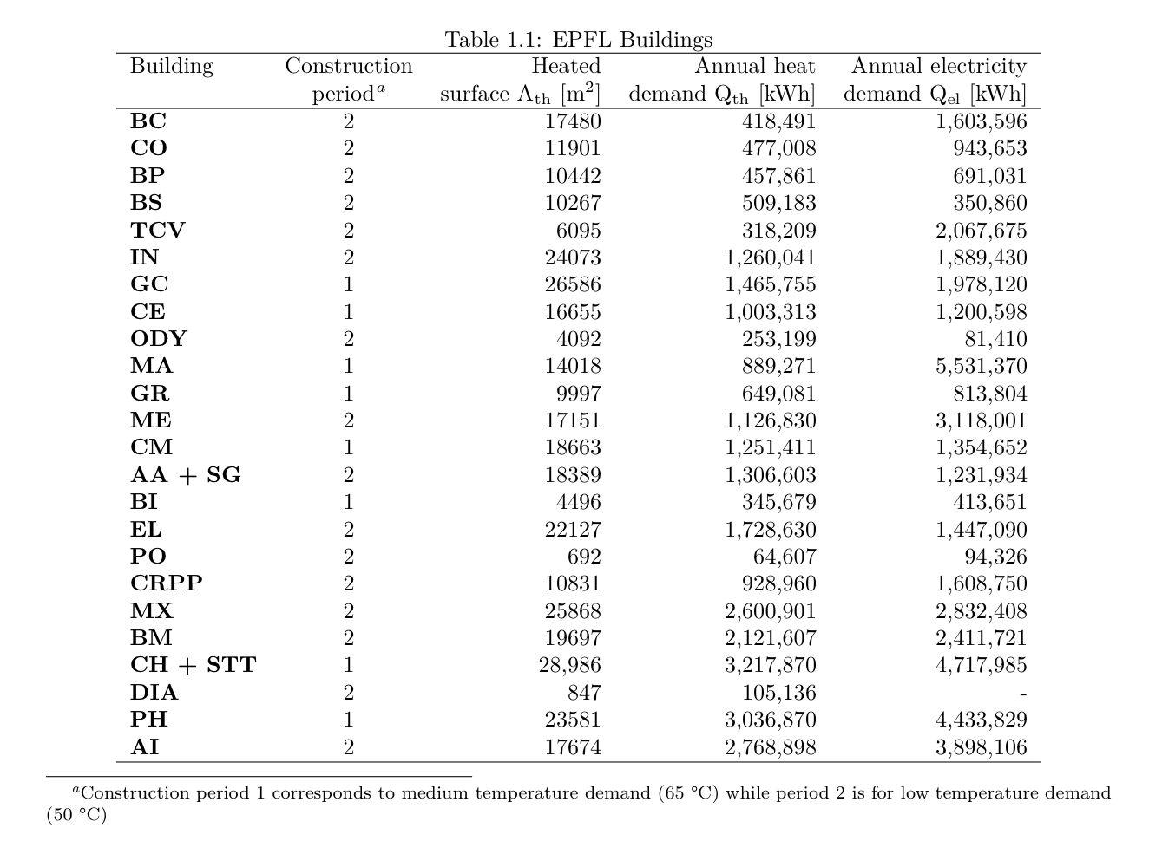
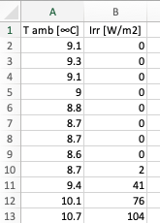
Data processing
Conduction & Ventilation
Internal gains
Solar gain
Buildings.csv
  Weather.csv

Slide 5
Assumptions
Conduction & Ventilation
Internal gains
Solar gain
80%
21 °C
Buildings.csv
Uniform Distribution
Mo – Fr; 7AM – 9PM
We’ll use some initial values for this for now. Say Kth = 4 and Ksun is 0.05
In the next step you’ll calculate it using NR
Buildings.csv
Project description: Figure 1.1 & Table 1.2

Slide 6
Hourly Profiles
Buildings are functioning only between 7 AM and 9 PM, between Mondays and Fridays (Saturdays and Sundays, they are not in use)
Build the profile of the building operation with this for a week and then from there a year
Gains from electric appliances are only during these operational hours
Occupancy profiles of buildings is needed for heat gains and each building has a share of classroom area, self-service restaurant area and an office area
This profile of the days are used to construct occupancy profiles of weeks and subsequently the whole year like before

Slide 7
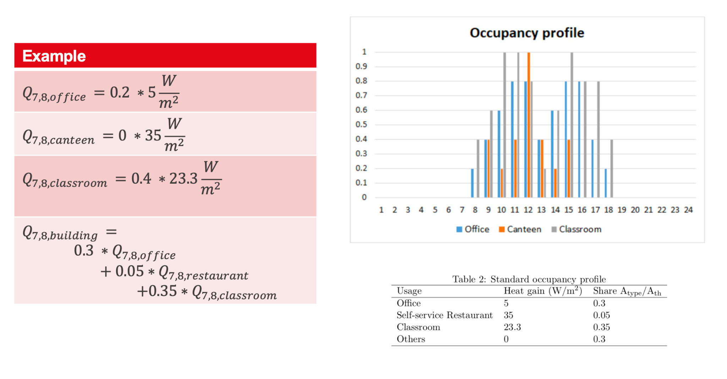
How to calculate heat gains from people ?
ATTENTION: Assume this is a wet lab and the heat gains is 50 W/m2, and do the calculation. This will also become important for the next part that involves NLP (part 2)

Slide 8
Hourly profile for each building
Conduction & Ventilation
Internal gains
Solar gain
Plugging in all the data we processed into the above equation, we will have hourly profiles for each building.
But now, we have to identify the conditions in which the heating system is actually turned on and use only these data.

Slide 9
Conditions for heating
What is the minimum external temperature at which you should consider heating? Should there be some tolerance here?
Should we heat when the buildings are closed?
Should we consider cooling needs? (For simplicity and the sake of this project, we can assume there are no cooling needs)
Translate the answer to these questions into logical statements that will allow you to identify the real heating load

Slide 10
Your TODOs
Other aspects:
One zoom meeting per week with your TA is possible (rendez-vous needed, elaborate your questions in detail and send it to your TA 2 days before the meeting)
Form a Group (in moodle) : to be finished before next week
Set up Tools (Mattermost, Virtual machine, Quarto) and test if they work well
Download Project files from moodle - Project description.pdf
Get started with Part 1 Task 1 – Project materials on gitlab and Quarto Tutorial on moodle
If you are fast, start reading about Task 1.2 where you will use Newton-Raphson to find the values of k_{th} and k_{sun}. More information on that task will come next week.

Slide 11
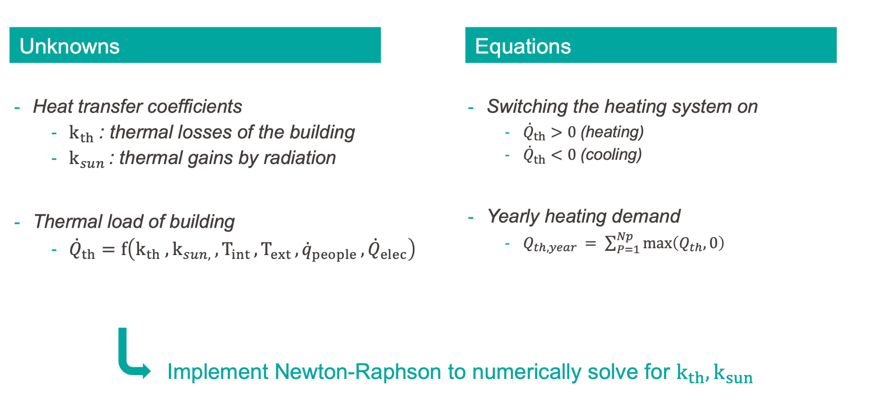
Calculation of building thermal properties
Yearly heating demand
  Hourly heating demand
  Switching the heating system on
Mean heat gains
  Switching off the heating system
Attention: Properly identify the conditions when the heating system is on/off

Slide 12
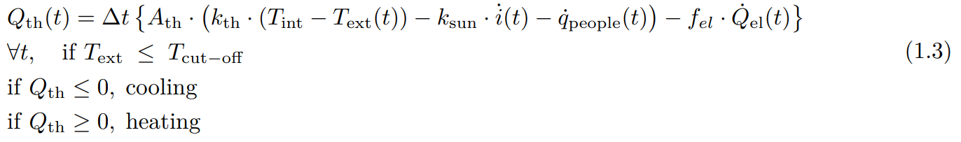
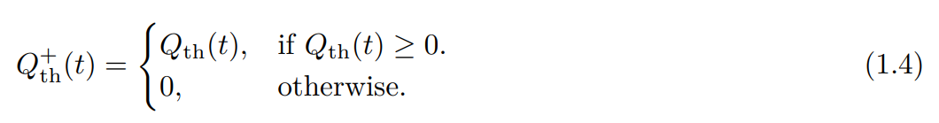
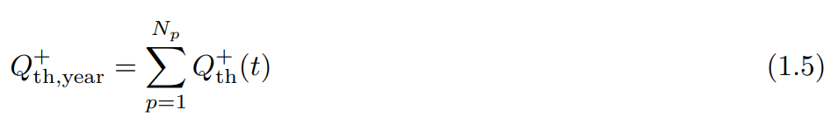
Yearly heating (equation 1)
Hourly heating demand :
Keep only the positive values, remember, we are designing a heating system :
You will have 8760 hourly entries (zero and/or non-zero). Add them all together to get the yearly demand :
Page 6
Project description

Slide 13
Mean heat (equation 2)
For this equation to work, you will need to compute the mean heat gains (solar, people and electric) of the values only when the outside temperature is between 15ºC and 17ºC (16ºC ± 1ºC).
This will give you the second equation to solve for.
Page 7
Project description

Slide 14

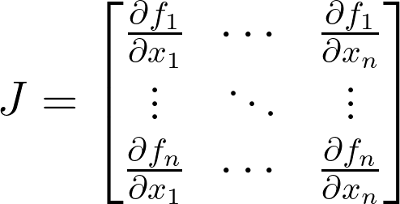
Solving the equation
To find the k-values of each building we will use such that F(x) = 0, we will use the Newton-Raphson method.
Newton’s method for a multivariable problem next iteration is defined as :
It is up to you to choose the initial value of and do the code implementation.
Remember, the Jacobian is defined as :

Slide 15

Debugging
Verify that your implementation of Newton-Raphson works with a simple equation.
Check units and signs.
Use different starting values.
Print or save your iterations to understand how your code is performing.

Slide 16
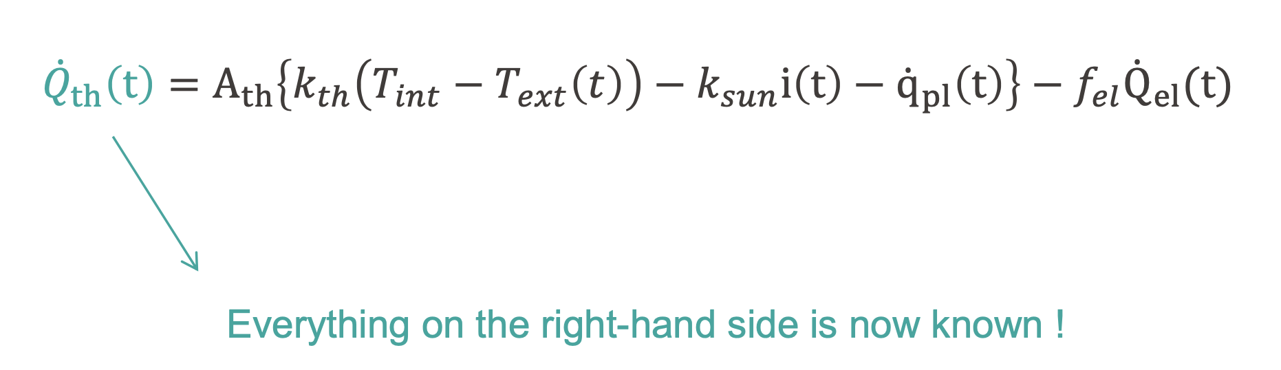
Calculation of the hourly profiles

Slide 17
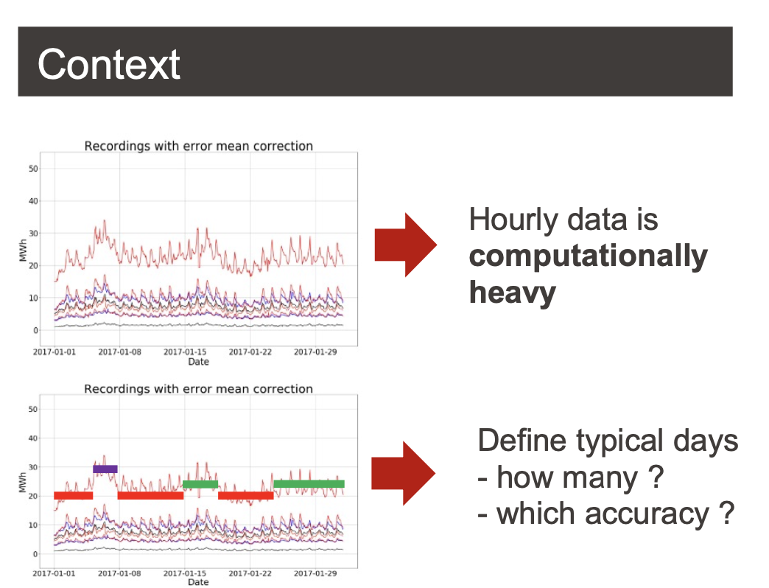
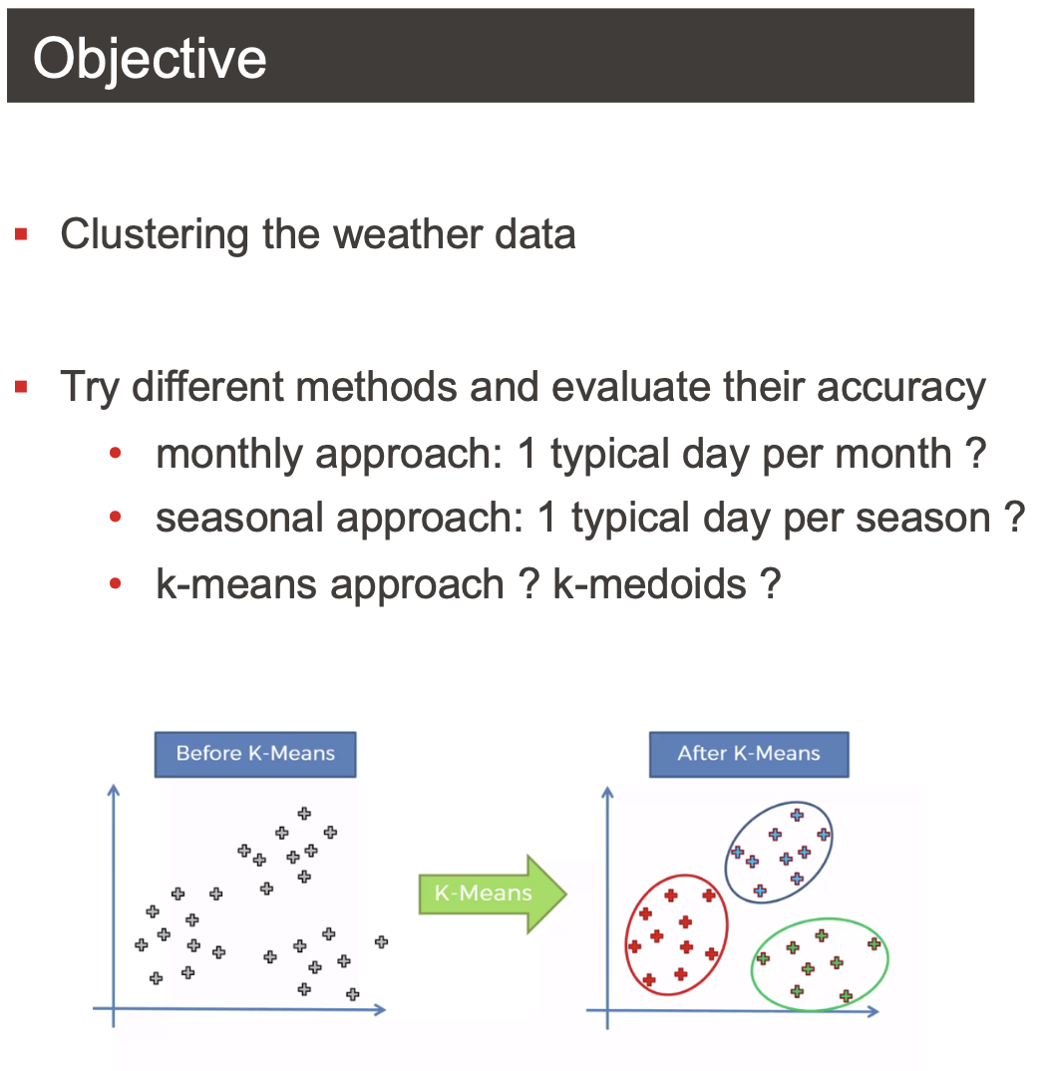
Clustering of typical days

